Slide 1
FREE HEALTH SERVICES VS. UNIVERSAL HEALTH COVERAGE
FINANCING
EQUITY
JUSTICE
ACCESS
QUALITY
RIGHT
GOVERNANCE
UPENDRA DEVKOTA
MADHU DIXIT DEVKOTA

Slide 2
FREE HEALTH SERVICES
Provision of essential health care services free of cost to the targeted population
UNIVERSAL HEALTH COVERAGE
Ensuring that all people obtain the health services they need without suffering financial hardship

Slide 3
HEALTH SERVICES: CONTEXT
National Health Policy 1991: PHC based, emphasis on service availability (nearest to rural population)
Second Long Term Health Plan 1997-2017: EHCS made accessible to all population
Health Sector Strategy 2004 (NHSP I, II, III): Focus on system strengthening, Provision of affordable and quality health services for all,
Position Paper 2006: Address inequities, focus on socio-economically marginalized population

Slide 4
HEALTH SERVICES: CONTEXT
Interim Constitution 2007: Health as a right, special attention to vulnerable group, abolish of user fees (to increase access and utilisation of health services)
Free Health Services: Came as a result of people’s movement, introduced in phases
2006: Free ER and IPD services for ultra poor, poor, destitute, elderly, disabled, FCHVs; / OPD service fee for targeted in low HDI districts
2007: EHCS free to all users at all S/HP
2008: all EHCS at PHCCs
2009: All services + drug free to targeted groups in hospitals (≤ 25 beds)

Slide 5
ACHIEVEMENT SO FAR
SIGNIFICANT REDUCTION IN MATERNAL AND INFANT MORTALITY
DELIVERY ATTENDED BY SKILLED BIRTH ATTENDANT HAS INCREASED BY 7 FOLDS IN LAST 2 DECADES
ALMOST 90% OF IMMUNIZATION COVERAGE (POLIO ALMOST ERADICATED)
TFR REDUCED TO 2.6 PER WOMAN
LEPROSY IS ON VERGE OF ELIMINATION
LIFE EXPECTANCY HAS INCREASED TO ~69 YRS (FROM 32 YRS) IN LAST 50 YEARS

Slide 6
SOME FACTS AND FIGURES
Example from Maternal Health

Slide 7
AFFORDABILITY & QUALITY: PERCENTAGE OF HEALTH CONSULTATIONS FOR ACUTE ILLNESSES BY TYPE OF INSTITUTION

Slide 8
Issue of equity

Slide 9
SERVICE DELIVERY & ACCESSIBILITY: INSTITUTIONAL DELIVERIES BY TYPE OF HEALTH FACILITY VISITED

Slide 10
EVIDENCE OF OVERCROWDING: TREND OF BED OCCUPANCY MATERNITY
WHO benchmark as 80%

Slide 11
IMPLICATION ON INFRASTRUCTURE
Hospital | Total deliveries | Additional demand | Existing beds | Existing bed days | Need bed days | Required total beds | Need of additional beds | Tentative size of building in Sq.ft. | Additional Cost NRs in million
Seti | 4953 | 100% | 25 | 9861 | 20440 | 70 | 45 | 8400 | 25.20
Bheri | 4421 | 100% | 28 | 9490 | 20440 | 70 | 42 | 7840 | 23.52
Western Regional | 9374 | 100% | 72 | 21569 | 43800 | 150 | 78 | 14560 | 43.68
Bharatpur | 9692 | 100% | 75 | 21627 | 43800 | 150 | 75 | 14000 | 42.00
Janakpur Zonal | 10276 | 100% | 35 | 20568 | 42340 | 145 | 110 | 20533 | 61.60
Koshi | 9365 | 100% | 99 | 25431 | 51100 | 175 | 76 | 14187 | 42.56
Total | 48081 | 100% | 334 | 108546 | 325637 | 760 | 426 | 79520 | 238.56

Slide 12
IMPLICATION FOR HUMAN RESOURCES
Hospital | HR | Existing | Norms | Gap | Additional cost in Million for HR per year
Seti Zonal | Nurses | 8 | 28 | 20 | 5.68
 | Doctor | 2 | 7 | 5 | 1.54
Bheri Zonal | Nurses | 13 | 25 | 12 | 3.43
 | Doctor | 2 | 5 | 3 | 0.92
Western Regional | Nurses | 34 | 56 | 22 | 6.08
 | Doctor | 4 | 11 | 7 | 2.16
Bharatpur | Nurses | 27 | 55 | 28 | 7.95
 | Doctor | 6 | 11 | 5 | 1.54
Janakpur Zonal | Nurses | 13 | 59 | 46 | 12.80
 | Doctor | 7 | 11 | 4 | 1.23
Koshi Zonal | Nurses | 34 | 54 | 20 | 5.46
 | Doctor | 7 | 11 | 4 | 1.23
Sub total |  | 28 | 56 | N 148, D 28 | 50%
Incentive 10 % |  | 129 | 277 | 148 | 5.00
 | Total |  |  |  | 55.03
WHO Standard
4 Doctor & 20 nurse for 3500 births

Slide 13
STOCK OUT OF ESSENTIAL DRUGS
Prasai Devi, Review of Studies on Nepal’s Free Health Service Programme
PHCRD/DoHS/MoHP

Slide 14
CHALLENGES REMAINS
Access to health services
Inadequate infrastructure and technology
Inappropriate human resources management
Emerging diseases and non-communicable diseases
Double burden of malnutrition
Preparedness for epidemics and natural disasters
Emerging threats (climate change, new diseases)
Ageing… Increasing demand, growing populations and ever-more-sophisticated and expensive tech­nologies.
Infinite needs… Finite resources

Slide 15
SO, WHAT DO THE ABOVE REALITIES MEAN FOR
UNIVERSAL HEALTH COVERAGE..?

Slide 16
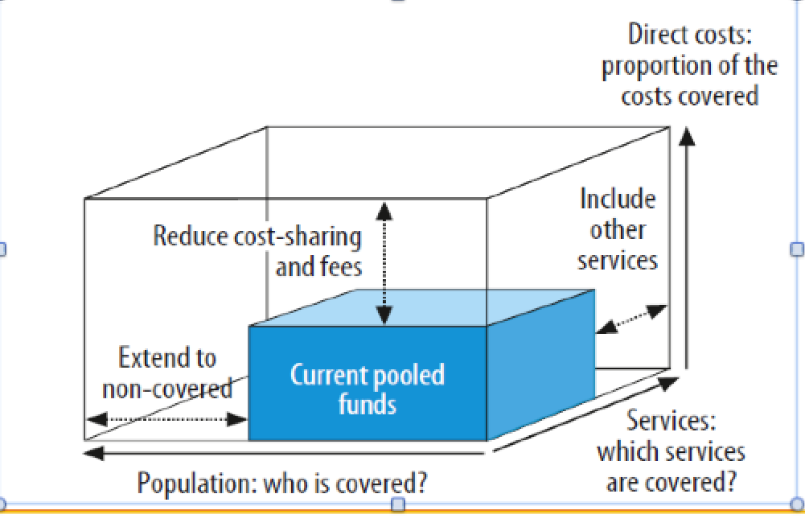
UNIVERSAL HEALTH COVERAGE
End goal:
Improved access to health services
Improved health outcomes
Providing financial risk protection
Prerequisite
Strong, efficient, well-run system
People-centred integrated care
Affordability – to reduce financial hardship
Access to essential medicines and technology
Sufficient capacity of well-trained, motivated HWs

Slide 17
NEPAL’S MOVE TOWARDS UHC….
National Health Insurance Policy 2013
Increase access to health care (mainly for disadvantaged populations)
Increase financial protection (promoting pre-payment and risk pooling)
Autonomous National Health Insurance Board planned
Is health insurance the only way towards UHC..?

Slide 18
NEPAL’S MOVE TOWARDS UHC….
Approach it with a broad mind set for overall health of population and beyond the conventional pay-per-procedure approach
Invest on health education and literacy to promote healthy behaviour
Prioritise the clinical services that have the most impact: immunization, family planning and antena­tal care.
Reach the unreached
Build on strength, network of institution and workers till community
Partner with private sector

Slide 19
NEPAL’S MOVE TOWARDS UHC….
Nepal would have to take stock of its reality and chalk out its own path
Introducing structural and regulatory approaches such as tobacco taxation, clean-air, road safety
Direct research and development towards the strongest drivers ensuring food and nutrition security, low-cost, high-impact innovations, such as less-polluting cooking stoves
Nepal has shown the way to the world through community based interventions we should built on that.

Slide 20
REMEMBER
Not a one-size-fits-all concept
Not coverage for all people for everything
Determined by three critical dimensions:
who is covered
what services are covered
how much of the cost is cover
WHO 2010
Nepal would have to take stock of its reality and chalk out its own path

Slide 22
The way forward…
Institutional capacity building
Good governance
Political commitment
Partnership with private sector for secondary and tertiary care financed through insurance
EHCS government’s prerogative

Slide 23
Perfect Health
An illusion to be chased
Never achieved
UHC …?

Slide 24
THANK YOU

